Slide 1
Sean Denniston, Annette Benbow
Arlington Historical Society

Slide 2
Agenda
Welcome and Introductions
Goal of Meeting and VA250
Timeframe for Activities and Events
Around the room
Name and organization?
What does your organization do?
Resources available: state, county, AHS
Around the Room: event ideas
Next steps
Next Meeting

Slide 3
VA 250
Celebrating the American Revolution of ideas
Commemorating struggles toward that ideal country
Failures and successes
Hearing all voices through the centuries and today
Events: 2024-2026 (and beyond?)
Notes:
Highlighting county events that led to independence
Statewide commemoration
• Multi-faceted and inclusive of all perspectives
• Every Virginian can see their story
Virginia’s history is America’s story.
In Virginia, the American Revolution was a war, and more than a war. It was a Revolution of Ideas.
• $1.5 Billion economic impact to Virginia
• 22,000 Jobs created across the Commonwealth
• $50 Million in state and local tax revenue
• 9 Million people participating in events and programs
• Extensive media impressions, interviews, articles, social media interaction

Slide 4
Around the Room
Who?
Organization?
What does your organization do?

Slide 5
State Resources: Education
Traveling exhibitions
Part I: 5,000 sq. ft. museum exhibition with online component for schools
Part II: Traveling Panel Exhibition for schools, community centers, museums
Notes:
Part I: 5,000 sq. ft. cutting-edge museum exhibition with online component for schools
Part II: Traveling Panel Exhibition
Provided to localities, at no cost, for display in small museums, libraries, community center

Slide 6
State Resources: Education
Mobile Museum: BIGGER than the Civil War 150 History Mobile
Notes:
Provided to localities, at no cost
For planners: networking
Opportunities to partner, such as Fairfax county included, Arlington, Alexandria City, Fairfax City, what remains of Fairfax County
Arlington House, Abingdon, Mt. Vernon

Slide 7
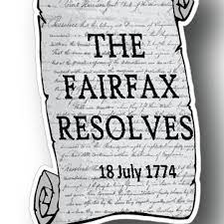
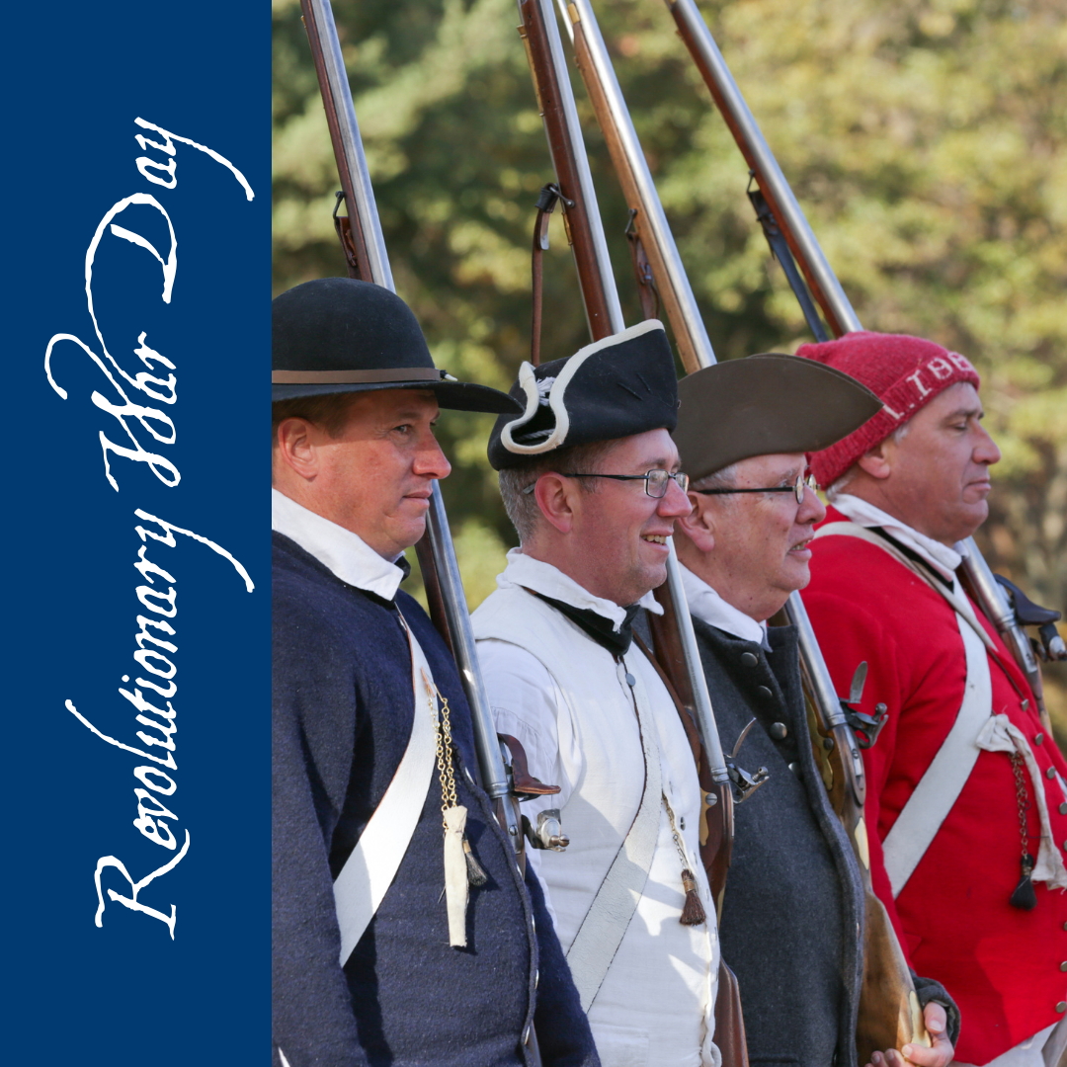
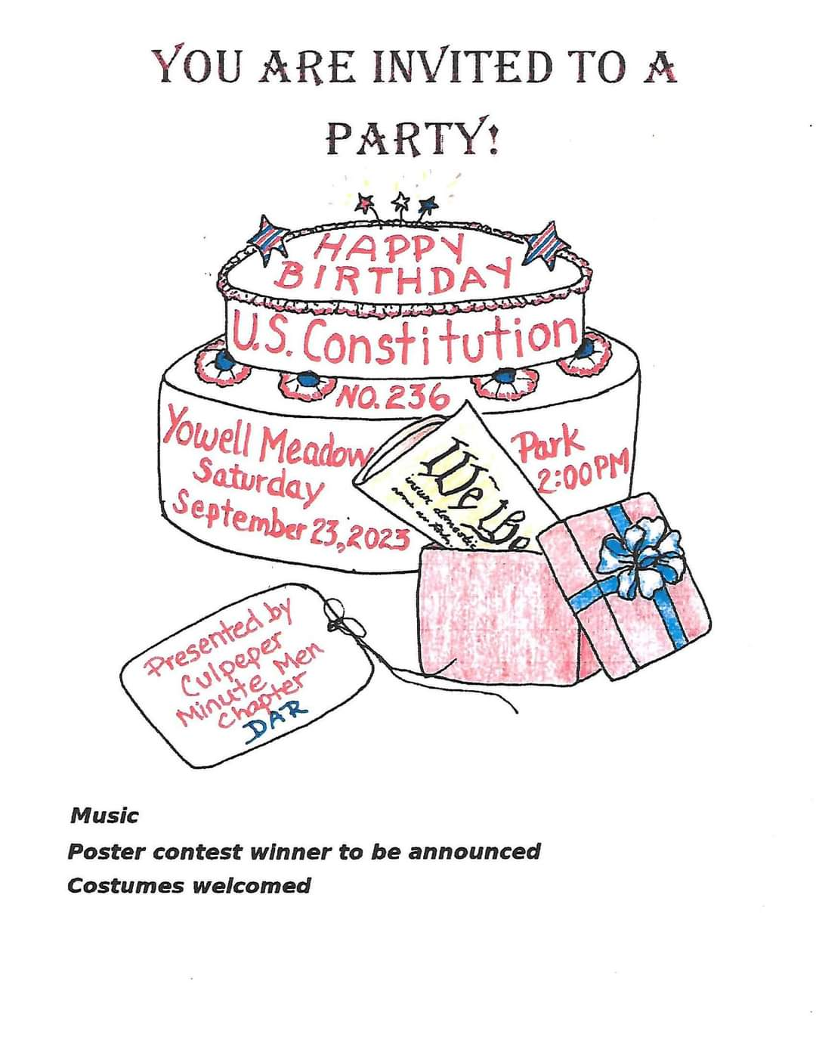
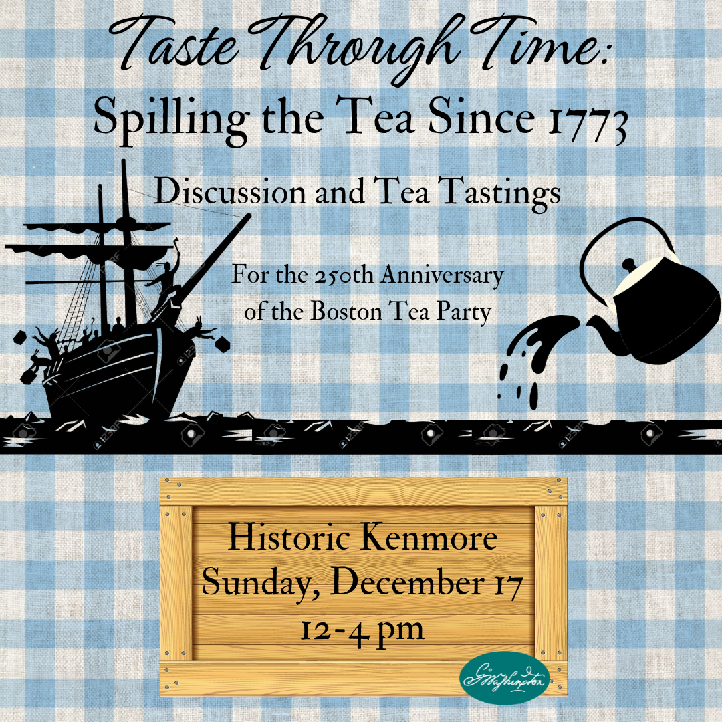
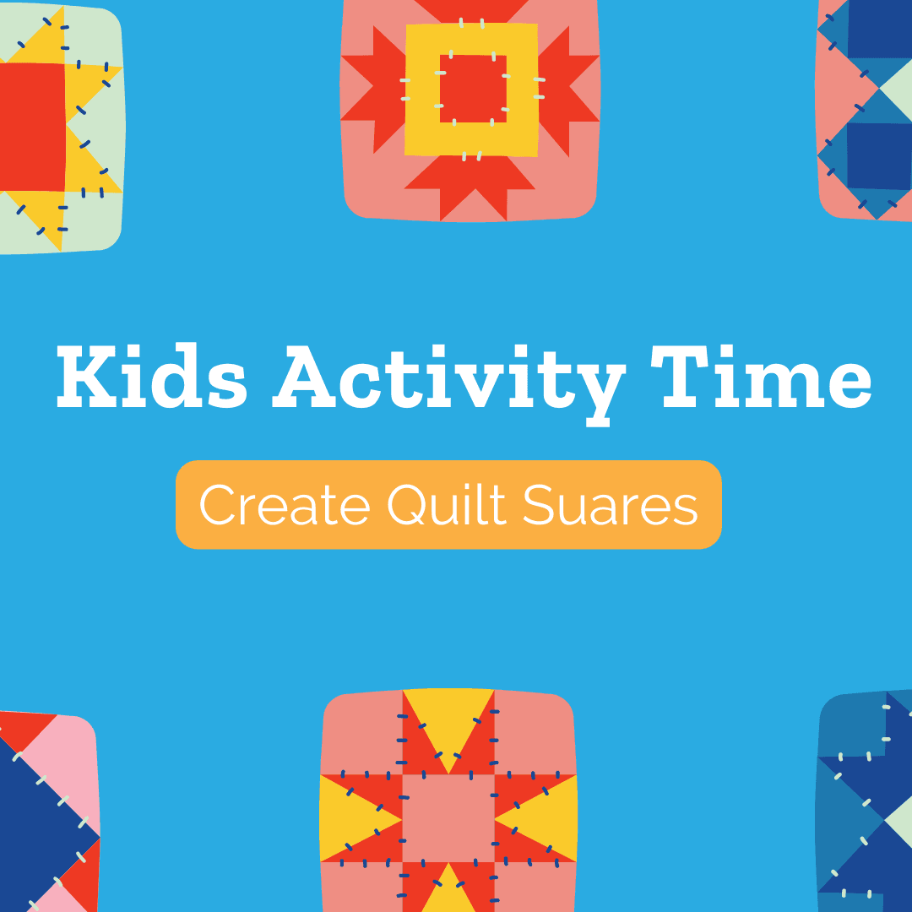
State Resources: Marketing
Interactive statewide calendar of events
Dedicated county page on VA250.org
Highlight local history, events
Amplification of events across social media
Notes:
Plus all our own media and social media platforms
Considering online Arlington VA250 event networking space

Slide 8
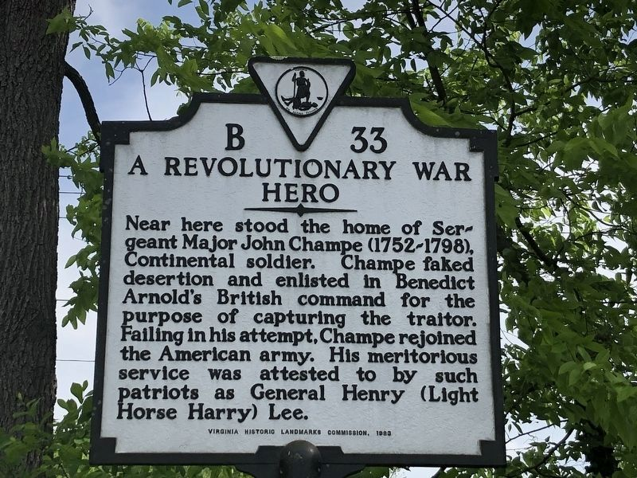
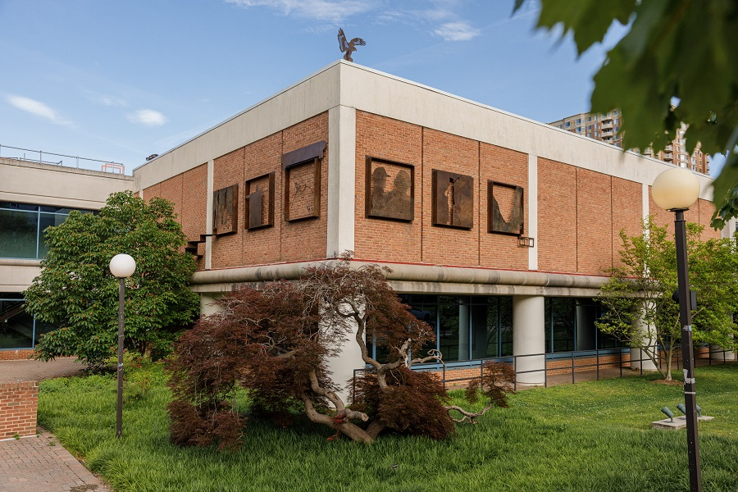
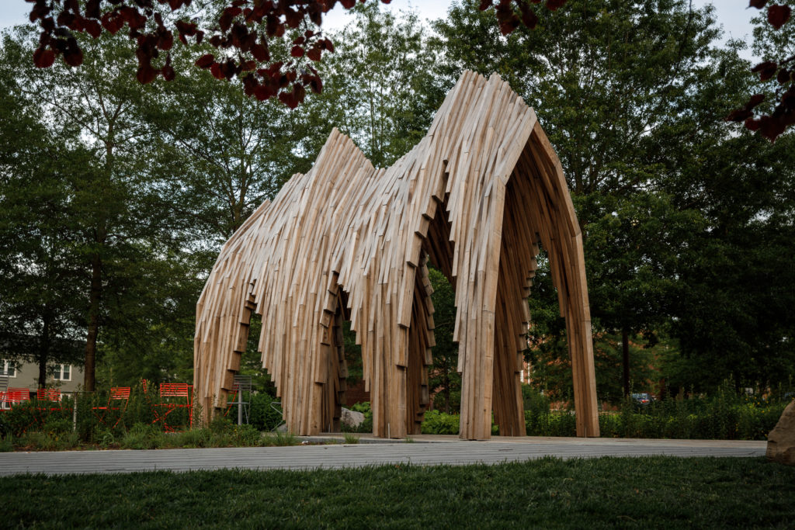
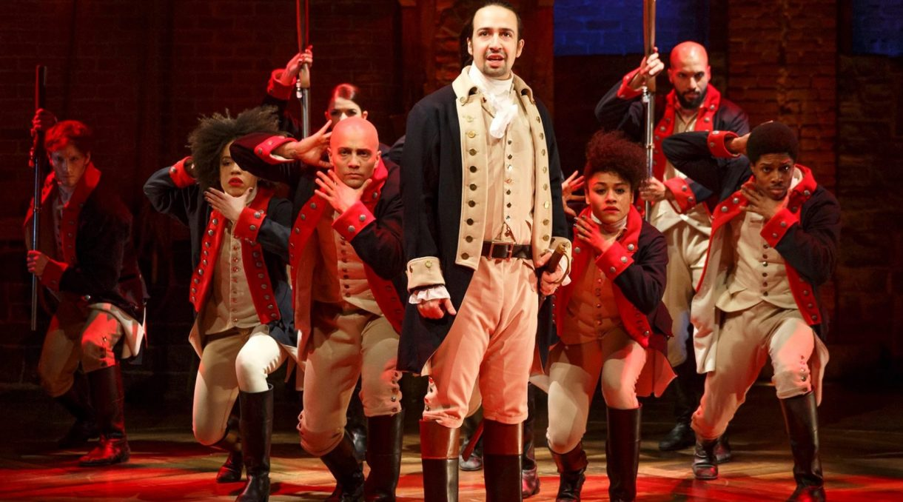
State Resources: VA250 Grants
Virginia Tourism: marketing events
Road to Revolution markers
Virginia Humanities
Content Development
Exhibitions
Events
Book series
Virginia Commission for the Arts
Any kind of art
Notes:
Three sources of State grants so far. Some are matching
Tourism:
Marketing: advertising, brochures, pamphlets, flyers online paid advertising
Road to Revolution markers: similar to Civil War trails Civil War Trails 40 so far.
Interpretive signage
Humanities:
Funding for content development for any kind of program or exhibition
VA Commission for the Arts

Slide 9
Brainstorming
Kids
Lecture
Lecture
Concert
Recitation
Lecture
Re-enactment
Cooking
Parade
Play
Plaque dedication
Poetry
Notes:
I got the sense in email with some of you that some of you may already have ideas for events.
We have a few minutes before we go to next steps so I thought we could take a few minutes to think out loud.

Slide 10
Next Steps
What’s our local story?
Request traveling programs, plan events around them
Make a plan of events
Keep stats
Create a VA250 microsite
After meeting report
Notes:
What’s our local story?
Identify stories and sites that have contributed to the legacy and vibrancy of our state and nation throughout our history
Request traveling programs as they become available and plan events around them
Create a VA250 microsite on VA250 as a beginning way to let the state know that Arlington is in on this.
Once completed with the state’s tech guy, we can begin to add places to visit and later events.
These would go not just on the VA250 site, but also on Virginia.org
Make a plan of events
Keep stats: aids in getting future grants, and economic assessments
After meeting report is something AHS can generate to send to all of you and to other Arlignton organizations that plan to participate.
We’ll also use it to issue a press release.

Slide 11
Next Meeting
When?
Community Center
Zoom enabled
Notes:
Make a plan of events
What’s our local story?
Identify stories and sites that have contributed to the legacy and vibrancy of our state and nation throughout our history
Create a VA250 microsite
Add Events and Places to Visit to VA250.org and Virginia.org
Keep stats: aids in getting future grants, and economic assessments
Request traveling programs as they become available and plan events aroundthem

